Slide 1
Programming
2016.5.02, PPR meeting
Damien Zufferey
Ongoing work with Martin, Stelios, Daniela, Ankur, Joseph, …

Slide 2
Automated Software Verification
Proof
Spec.
Counterexample
Notes:
“Beware of bugs in the above code; I have only proved it correct, not tried it.” Donald Knuth

Slide 3
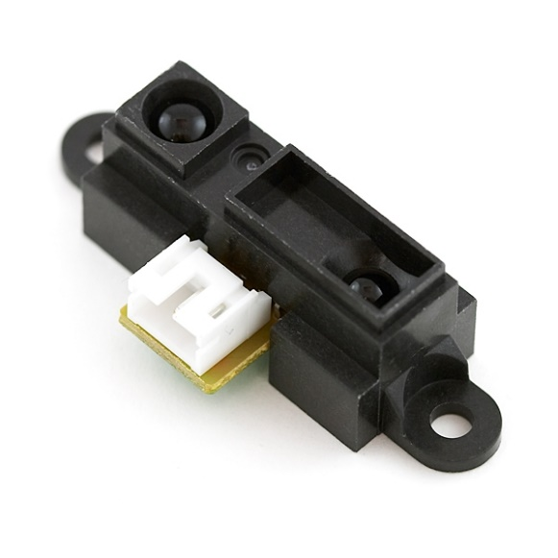
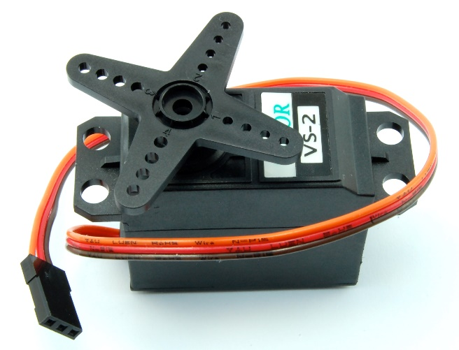
Bird's-Eye View of a Program
Servo servo;
servo.attach(9);
int v = analogRead(A0);
v = map(v,0,1023,0,180);
servo.write(v);
Input
Output

Slide 4
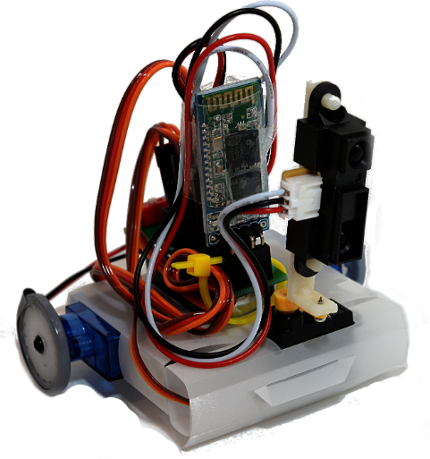
The Program is Only Half of the Story
Continuous servo left
Continuous servo right
Servo holding the sensor
IR distance sensor

Slide 5
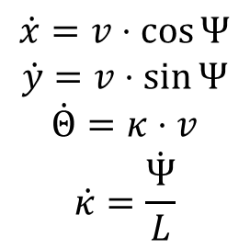
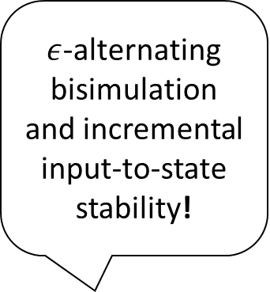

Meanwhile in the Literature …
$$\dot{x}=v⋅\cos{Ψ}$$
$$\dot{y}=v⋅\sin{Ψ}$$
$$\dot{Θ}=κ⋅v$$
$$\dot{κ}=\frac{\dot{Ψ}}{L}$$
$ε$-alternating bisimulation and incremental input-to-state stability!
$$⇔$$
Let a
move in a 2D discrete grid...
Notes:
Unfortunately, simple models and complex arguments only come with an expert in the loop.
Expert in the loop:
come up with a model
justify that the model corresponds to the

Slide 6
Talos
Submitted to OOPSLA 16

Slide 7
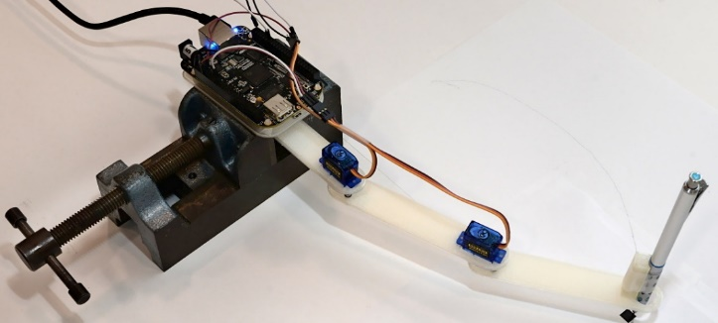
“Full Stack” Robot Compiler
Control logic
Robot design
Software
Component
React
Robot
Compiler
[Mehta et al. 14]
Manufacturing
Models
Verifier
Parameter values
Spec.
Satisfy spec. yes/no
Notes:
Full stack but with simpler robots
Take advantage of 3D printing & co.

Slide 8
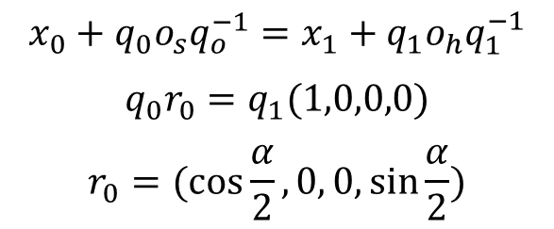
Robot Compiler
Arm = Component()
Arm.addSubcomponent("l0", Link)
Arm.addSubcomponent("l1", Link)
Arm.addSubcomponent("l2", Link)
l = Arm.addParameter("length")
Link.setSubParameter(("l0", "length"), l)
Link.setSubParameter(("l1", "length"), l)
Link.setSubParameter(("l2", "length"), l)
Arm.addConnection(("l0","servo"),("l1","horn"))
Arm.addConnection(("l1","servo"),("l2","horn"))
Arm.addSubcomponent("c", ArmCtrl)
Arm.addConnection(("c", "alpha"),("l0","input"))
Arm.addConnection(("c", "beta"), ("l1","input"))
Kinematic pairs
$$x_{0}+q_{0}o_{s}q_{o}^{−1}=x_{1}+q_{1}o_{h}q_{1}^{−1}$$
$$q_{0}r_{0}=q_{1}(1,0,0,0)$$
$$r_{0}=(\cos{\frac{α}{2}}, 0, 0,\sin{\frac{α}{2}})$$

Slide 9
React
class ArmCtrl extends Component(alpha,beta) {
var counter = 0
every( 1000 ) {
counter match {
case 0 => counter += 1
publish(alpha, α₀))
publish(beta, β₀))
case 1 => counter += 1
publish(alpha, α₁)
publish(beta, β₁))
case 2 => counter += 1
publish(alpha, α₂))
publish(beta, β₂))
case _ => counter = 0
} } }
The software is a component.
Periodic loops as first class object.
Event driven interaction (ROS compatible)
sensor[Int](IRsensor) {
case Int(i) => ...
}
Parameters

Slide 10
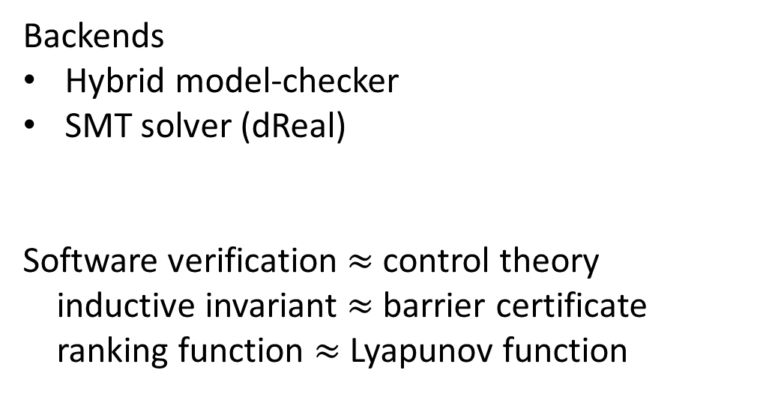
Verifier
Backends
Hybrid model-checker
SMT solver (dReal)
Software verification $≈$ control theory
inductive invariant $≈$ barrier certificate
ranking function $≈$ Lyapunov function
React
Robot
Compiler
Timed automaton
Nonlinear diff. eq.
Spec.
Verifier
FOL formula
Notes:
Automated verification

Slide 11
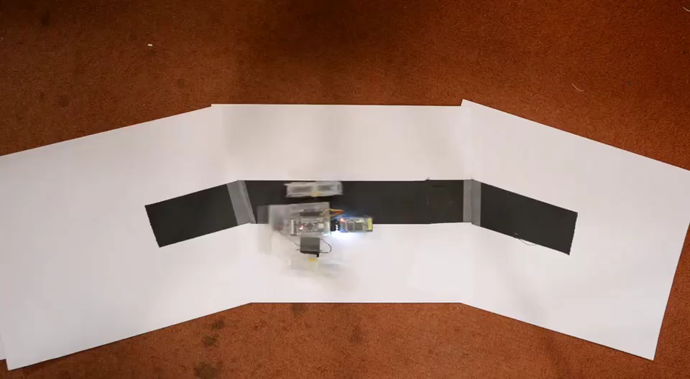
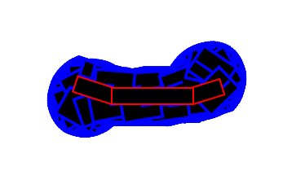
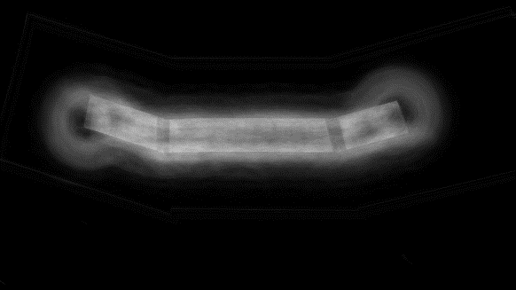
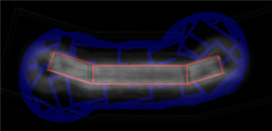
Example: Edge Follower
Verifier
State-space coverage
Background subtraction

Slide 12

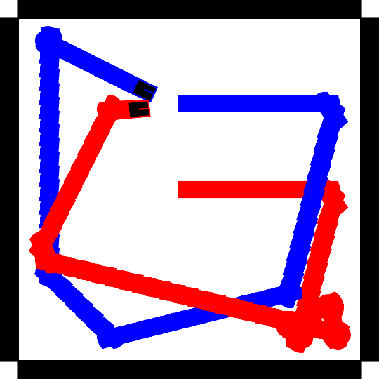
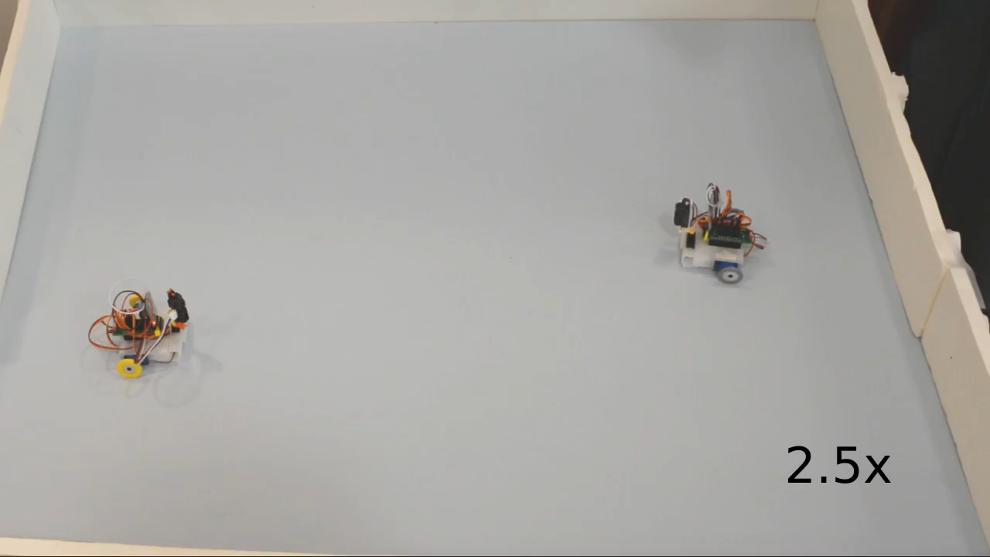
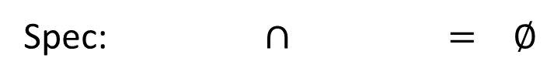
Example: Avoiding Collision
Verifier
Spec: $∩$ $= ∅$
Counterexample

Slide 13
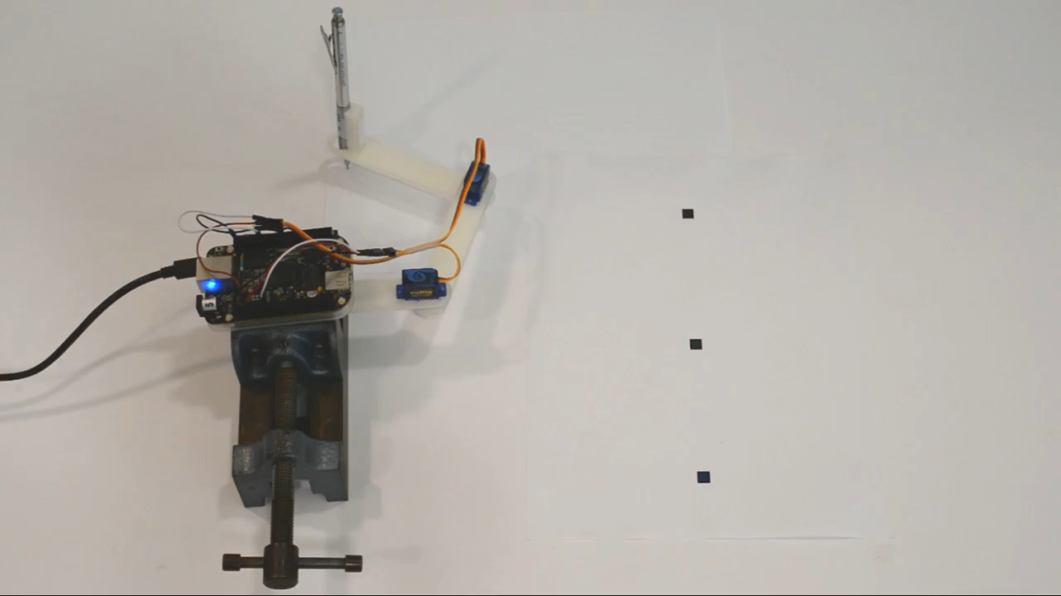
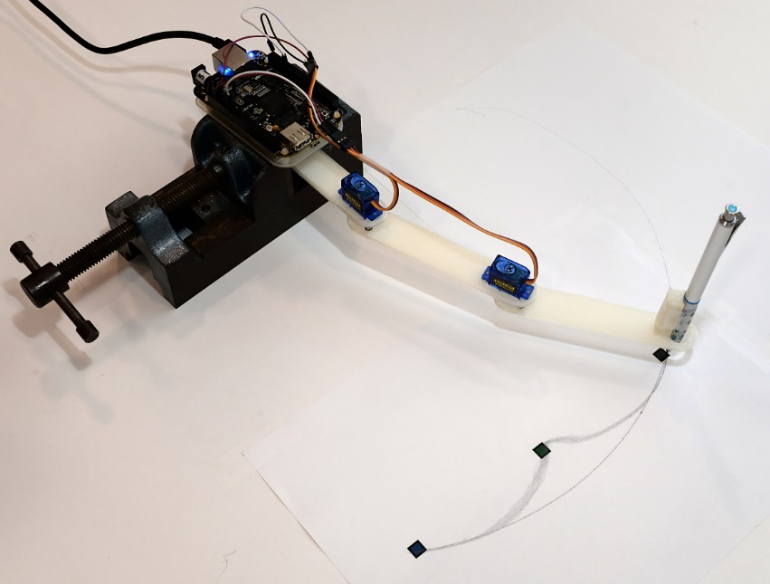
Controller/Robot Co-Synthesis
React
Robot
Compiler
$$\vec{O}$$
$$φ(\vec{I},\vec{O})$$
$$φ(\vec{P}, \vec{O}, \vec{I}, \vec{x},\vec{x}′)$$
$$\vec{P}$$
Goal
$$\vec{O}, \vec{P}$$
Synthesis
Notes:
A few words about rigidity
Verification = forward kinematic
Synthesis = reverse kinematic

Slide 14
A peek inside the solver
[TACAS 16]
Interpolants in Nonlinear Theories over the Reals
with Sicun Gao

Slide 15
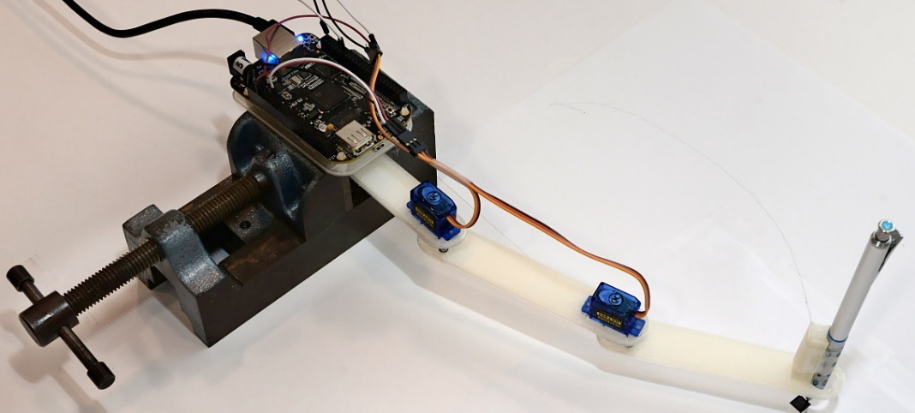
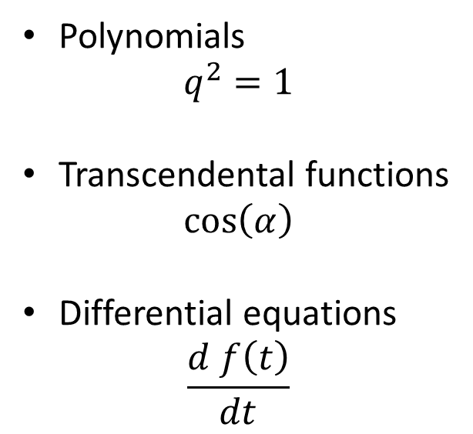
Kind of Constraints
Discrete
Polynomials
$$q^{2}=1$$
Transcendental functions
$$\cos\left(α\right)$$
Differential equations
$$\frac{d f\left(t\right)}{dt}$$
Continuous

Slide 16
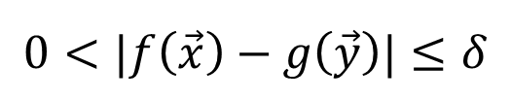

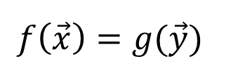
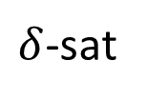
$δ$-Satisfiability
$ℝ$ + nonlinear theory $→$ undecidable
$ℝ$ + nonlinear theory + $δ$-perturbations $→$ decidable
|$f\left(\vec{x}\right)−g\left(\vec{y}\right)|=0$
$δ$-sat
$$f\left(\vec{x}\right)=g(\vec{y})$$
$$0<|f\left(\vec{x}\right)−g\left(\vec{y}\right)|≤δ$$
$δ$-sat / unsat
$$|f\left(\vec{x}\right)−g\left(\vec{y}\right)|>δ$$
unsat
$δ$-satisfiability captures numerical computability.

Slide 17

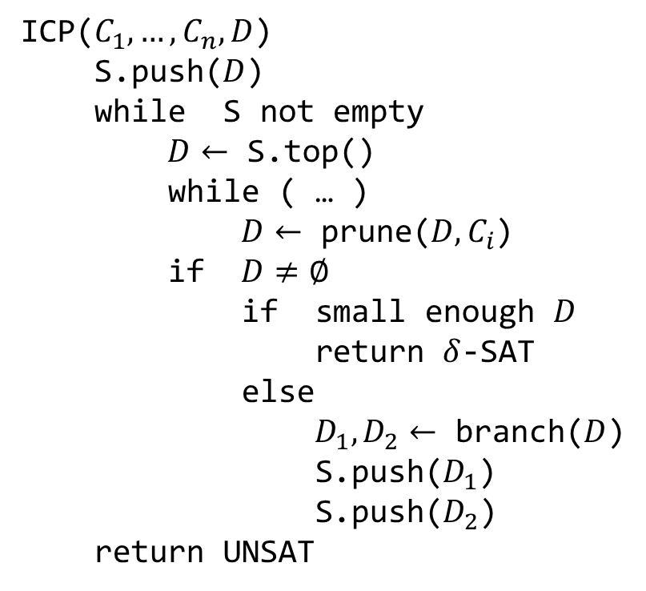
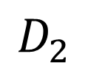
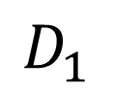
Branch-and-Prune ICP
ICP($C_{1},…, C_{n}, D$)
S.push($D$)
while S not empty
$D←$ S.top()
while ( … )
$D←$ prune($D, C_{i}$)
if $D≠∅$
if small enough $D$
return $δ$-SAT
else
$D_{1},D_{2}←$ branch($D$)
S.push($D_{1}$)
S.push($D_{2}$)
return UNSAT
$$D_{1}$$
$$D$$
$$D_{2}$$

Slide 18
Branch-and-Prune Example
Prune by B
Prune by A
Branch
Prune by A
Prune by B
Prune by A
Prune by B
A
B

Slide 19
How do we get simpler models ?
Effector
Link
Quantifier elimination
Very expensive
(doubly exponential, only for polynomials)
Link

Slide 20
How do we get simpler models ?
Effector
Link
Craig interpolation
Better complexity: co-NP
Link

Slide 21
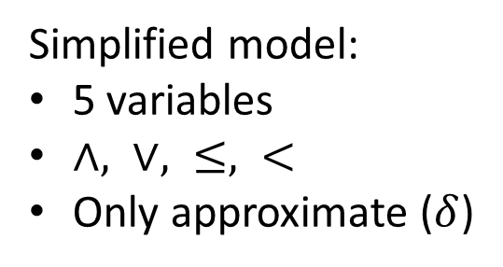
Interpolation as Weak Quantifier Elimination
Kinematic chain
Automatically extracted model:
30 variables
poly. deg. 2, trig. fct.
Simplified model:
5 variables
$∧, ∨, ≤, <$
Only approximate ($δ$)
Interpolation

Slide 22
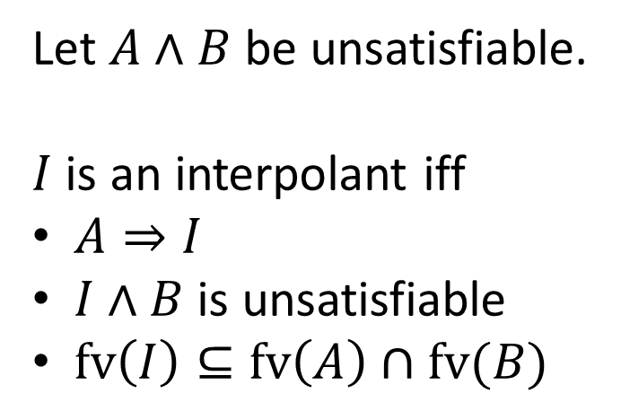
Craig Interpolation
I
Let $A∧B$ be unsatisfiable.
$I$ is an interpolant iff
$A⇒I$
$I∧B$ is unsatisfiable
$fv\left(I\right)⊆fv\left(A\right)∩fv(B)$
A
B
Usually, $I$ is computed from the unsatisfiability proof of $A∧B$.

Slide 23
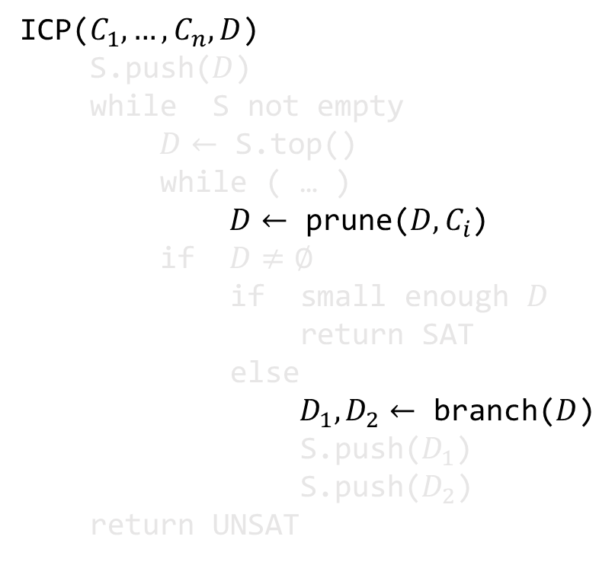

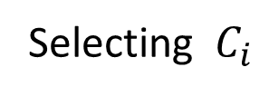
Proof from ICP: $D, C_{1..n}⊢ ⊥$
ICP($C_{1},…, C_{n}, D$)
S.push($D$)
while S not empty
$D←$ S.top()
while ( … )
$D←$ prune($D, C_{i}$)
if $D≠∅$
if small enough $D$
return SAT
else
$D_{1},D_{2}←$ branch($D$)
S.push($D_{1}$)
S.push($D_{2}$)
return UNSAT
Selecting $C_{i}$
Prune = Split + ThLem
Split

Slide 24
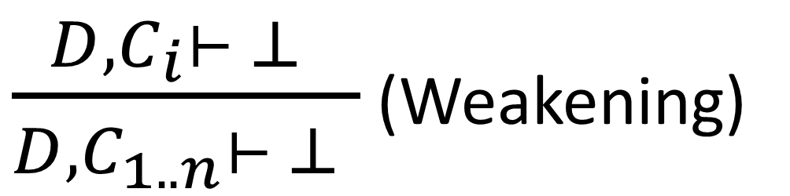
Selecting $C_{i}$
$\frac{D, C_{i}⊢ ⊥ }{D, C_{1..n}⊢ ⊥ }$ (Weakening)

Slide 25
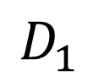
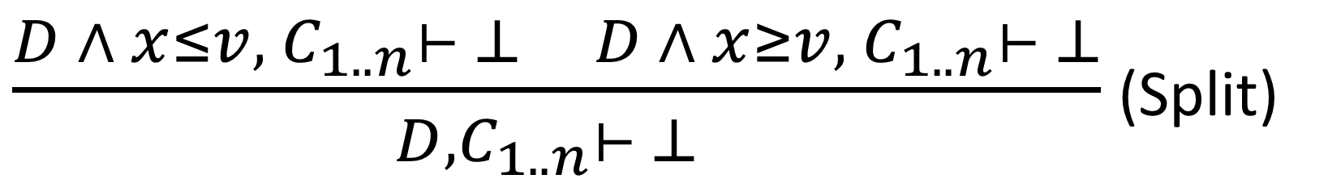
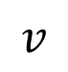

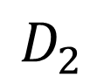
Branching
$$D_{1}$$
$$D_{2}$$
$$x$$
$$v$$
$\frac{D ∧ x≤v, C_{1..n}⊢ ⊥ D ∧ x≥v, C_{1..n}⊢ ⊥}{D, C_{1..n}⊢ ⊥ }$ (Split)

Slide 26
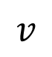
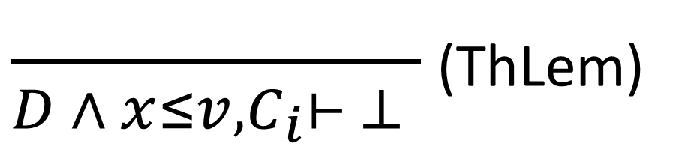

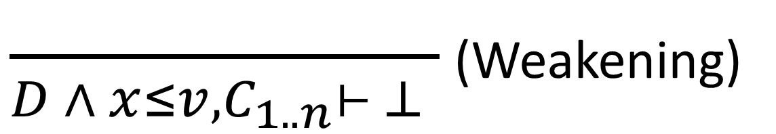
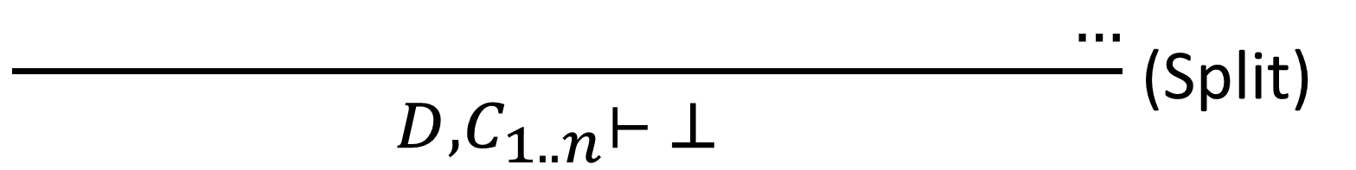

Pruning by $C_{i}$
$\frac{ }{D ∧ x≤v, C_{i}⊢ ⊥ }$ (ThLem)
$$x$$
$$v$$
$\frac{ }{D ∧ x≤v, C_{1..n}⊢ ⊥ }$ (Weakening)
$\frac{ …}{D, C_{1..n}⊢ ⊥ }$ (Split)

Slide 27

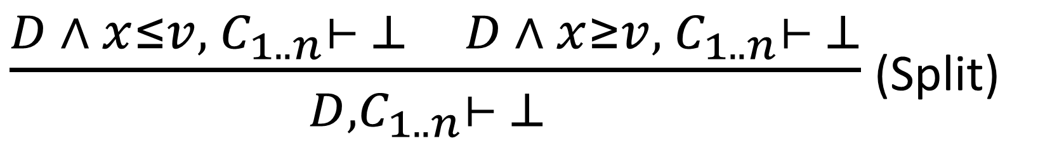


ICP Produces Resolution Proofs
$$¬D∨V∨¬C_{1..n}$$
$$¬D∨¬V∨{¬C}_{1..n}$$
$\frac{D ∧ x≤v, C_{1..n}⊢ ⊥ D ∧ x≥v, C_{1..n}⊢ ⊥}{D, C_{1..n}⊢ ⊥ }$ (Split)
$$¬D∨¬C_{1..n}$$

Slide 28

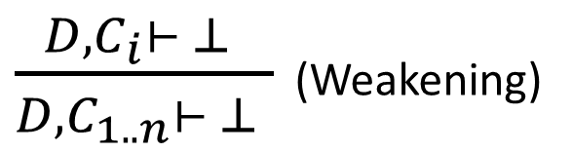

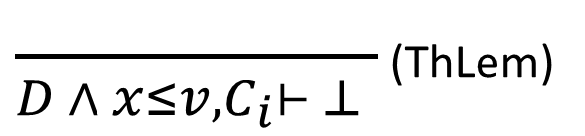


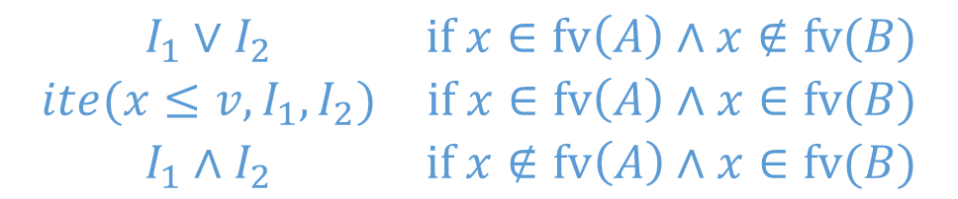
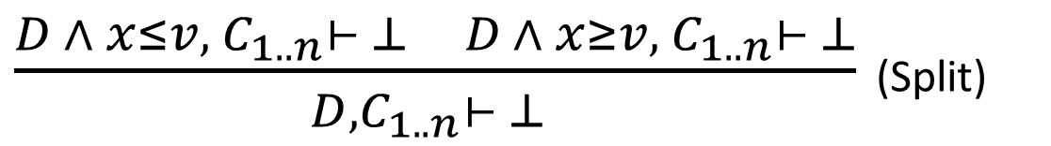
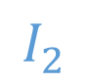
Interpolation Rules
$$I$$
$\frac{ }{D ∧ x≤v, C_{i}⊢ ⊥ }$ (ThLem)
$\frac{D, C_{i}⊢ ⊥ }{D, C_{1..n}⊢ ⊥ }$ (Weakening)
$$C_{i}∉A$$
$$I$$
$$I_{1}$$
$$I_{2}$$
$\frac{D ∧ x≤v, C_{1..n}⊢ ⊥ D ∧ x≥v, C_{1..n}⊢ ⊥}{D, C_{1..n}⊢ ⊥ }$ (Split)
$$\begin{matrix}I_{1}∨I_{2} & if x∈fv\left(A\right)∧x∉fv(B) \\ ite(x≤v, I_{1}, I_{2}) & if x∈fv\left(A\right)∧x∈fv(B) \\ I_{1}∧I_{2} & if x∉fv\left(A\right)∧x∈fv(B)\end{matrix}$$

Slide 29
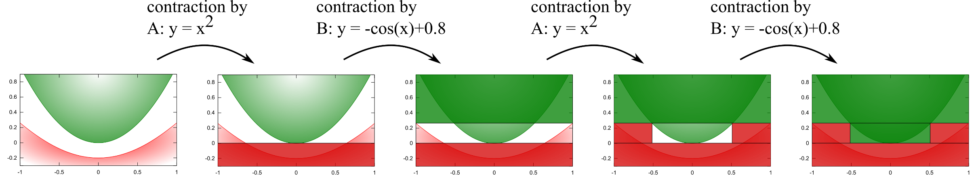
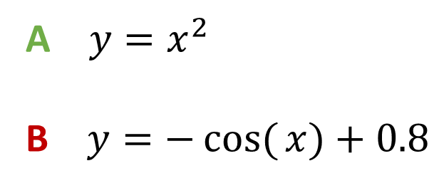
Example
A $y=x^{2}$
B $y=−cos({x)}+0.8$

Slide 30
Talos Summary
“Full stack” system
Control logic + physical design
Validation against specification and synthesis of parameters
Runtime and manufacturing
Technical contributions (inside the verifier)
More scalable algorithms for the SMT Solver
New features, e.g., Craig Interpolation
Future work
More scalable algorithms for the SMT Solver
The environment
Automatically going from continuous to discrete, compositional reasoning
Notes:
!!! dReal is used at Toyota research !!!

